Slide 1
Lesson 14 – Homework review

Slide 2

Remove obsolete code

Slide 3
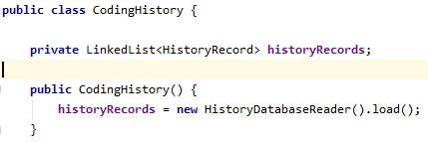
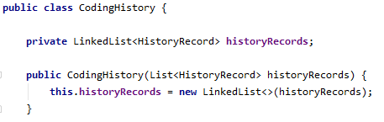
Follow Inversion of Control principle

Slide 4
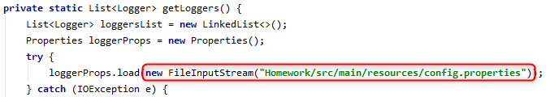
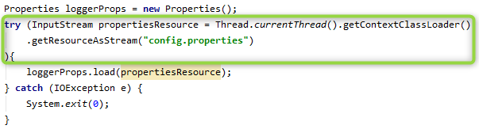
Do not hardcode paths

Slide 5
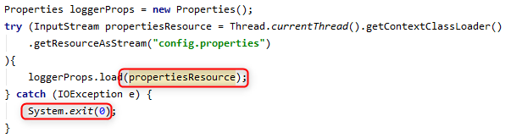
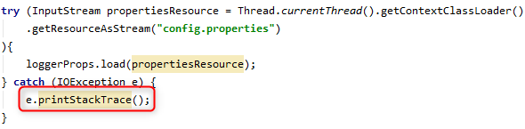
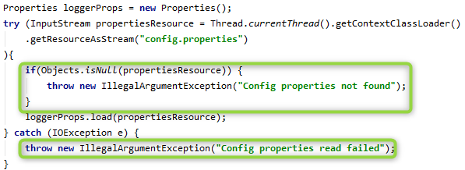
Correctly break the flow

Slide 6
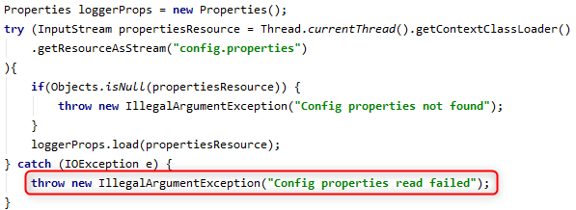

Add details to exceptions

Slide 7


Use descriptive naming

Slide 8
Write optimal SQL

Slide 9
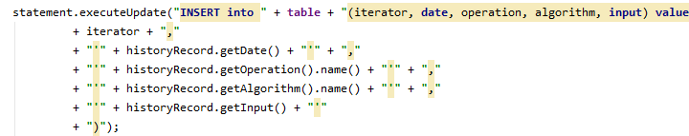
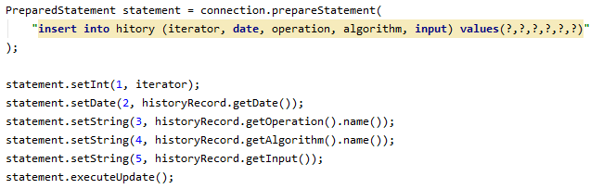
Write secure SQL

Slide 10
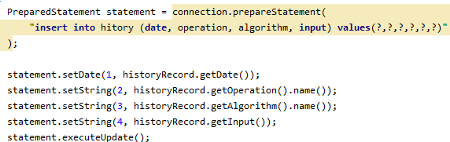
Use database built-in features

Slide 11
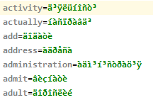
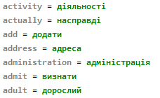
Use correct encoding

Slide 12
Apply all recommendations from personal feedbacks before starting the next homework

